Slide 1
Clickstream Analysis
- Vega Shetty

Slide 2
What is Clickstream Analysis?
Collecting and analysing data obtained from web server logs(i.e. the Clickstream data) to understand website usage patterns and user behaviour.
It helps create a digital map of the customer’s journey across a website so as to deliver a better customer experience.
It also allows product and marketing teams to identify opportunities and optimize their website or application to more impactfully reach users.

Slide 3
Why is it helpful?
Helps answer important questions:
- Is the users intention to browse, to search or to buy something?
- How does the user navigate through the website?
- How much time does the user spend on the website?
- Does the visitor come back or not?
- What is the visit-to-purchase/conversion ratio?
- How people got to the site?

Slide 4
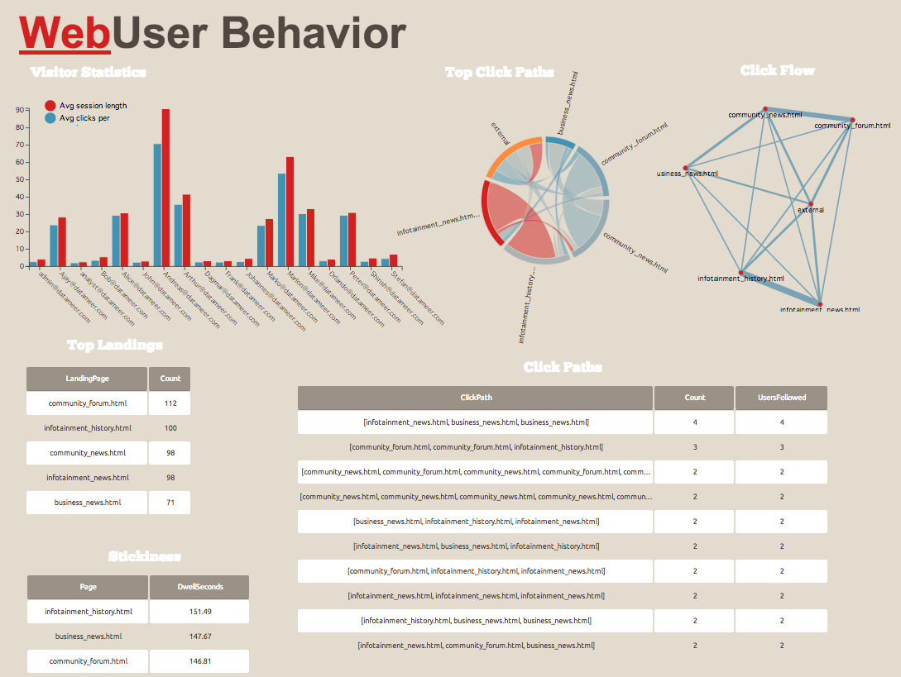

Slide 5
Clickstream data
Data from web server log file reveals :
- the IP address of the user
- the page (URL) the user requested
- the timestamp – duration of the event
- user session
Helps identify users, country, pages visited and time spent on website.
Other sources include Media service providers like DoubleClick, ISP providers like AOL and tracking programs.

Slide 6
Path Analysis
A click path is a series of links a site visitor follows.
Path analysis helps :
- To determine the sequences in which users have navigated the web site
- The path a user takes reveals goals and interests
- When can business intervene before a non-purchaser leaves the site
- Show the right information at the right time

Slide 7
Clickstream analysis today
E-commerce : Understand the shopping patterns such as –
- what pages the shopper lingers on
- what the shopper puts in or takes out
- what does he purchase
- what is his preferred payment method.
Traffic :
- tracks how many pages are served to the user
- how long it takes each page to load
- data transmission between clicks
E-business rely on big data analytics and related tools such as Hadoop.

Slide 8
Analysis on Snapchat
Based on UX research paper and users:
- Home UI – no onboarding, description
- Posting - easy to send and post stories
- Viewing - constant changes, confused in usage of features, not friendly
- Manage profile – not easy to navigate, lack of standard conventions

Slide 9

Assignment - Snapchat analysis
Various tracking tools are used for social media mobile applications. For e.g. Snaplytics, Delmondo
Provide information such as :
- Unique views
- Screenshots
- Completion rates
- Fall-off rate
- Time-of-day activity
- On-Demand Geofilter metrics

Slide 10
Thank you
Notes:
Based on these insights, businesses can restructure their website layouts, reconstruct the website content and tweak the advertising to get it right.

